Slide 1
LENDING RISK MANAGEMENT CASE STUDY Gramener Case Study SUBMISSION
Group Name:
Hoshedar Mody
Kishore Kumar Poosa
Vivek Mohan Singh
Krishna Teja ( no contact and participation )

Slide 2
Abstract- For Lending Risk Management and Decision Support System
Why did you start? – To Minimize Risk of Lending
Two types of risks are associated with the bank’s decision:
If the applicant is likely to repay the loan, then not approving the loan results in a loss of business to the company
If the applicant is not likely to repay the loan, i.e. he/she is likely to default, then approving the loan may lead to a financial loss for the company
What did you do? – Analyses and Analytics – Helping to make risk free or minimal risk Decisions
Analyzed and cleaned data to formulate the edifice of Lending Risk Management
The data contains the information about past loan applicants and whether they ‘defaulted’ or not. The aim is to identify patterns which indicate if a person is likely to default, which may be used for taking actions such as denying the loan, reducing the amount of loan, lending (to risky applicants) at a higher interest rate, etc.
In this case study, we use EDA to understand how consumer attributes and loan attributes influence the tendency of default.
Plotted Graphs and isolated the Potential Risk bearing prospective borrowers of the Loans
In other words, borrowers who default cause the largest amount of loss to the lenders. In this case, the customers labelled as 'charged-off' are the 'defaulters'.
If one is able to identify these risky loan applicants, then such loans can be reduced thereby cutting down the amount of credit loss. Identification of such applicants using EDA is the aim of this case study.
In other words, the company wants to understand the driving factors (or driver variables) behind loan default, i.e. the variables which are strong indicators of default. The company can utilise this knowledge for its portfolio and risk assessment.
What did you find?
Considering that Spark Funds wants to invest between 5 to 15 million USD per investment round, the investment type most suitable is Venture Funds
Top English speaking country is USA followed by Great Britain and India

Slide 3
For Lending Risk Management and Decision Support System
If the applicant is likely to repay the loan, then not approving the loan results in a loss of business to the company
If the applicant is not likely to repay the loan, i.e. he/she is likely to default, then approving the loan may lead to a financial loss for the company.
Risk of default is to weed out the potentially risky and prospective defaulters from the ones who are not that great a risk for defaults and delayed payments resulting in Charged-Off Loans.
As per the Data Dictionary numerous factors are affecting the decision to lend – Annual Income, Demographics , Revolving Balances, Charged-Off Loans , Home ownership and other which will help ascertain the creditworthiness and low risk borrowers.
Critical analysis using EDA and visualizations

Slide 4
Lending Risk Decision Support Methodology
Format Clean Up
Ensure Valid Data format
Clean data to enhance quality and format of Data
Extraction and Transformation
Transformed raw Data into Analytical form
Extracted valid accurate data for Analysis
Analysis and Decision making
Performed Analysis on Data
Transformed Data into Visual Plots to facilitate decision making

Slide 5
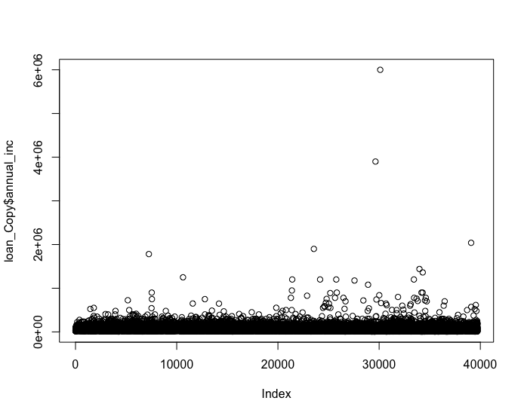
Data Cleaning and Enhancing
Removed columns with more than 90% NAs
48 Columns used in the Study
Annual Income bucket slot - annual_income_slot
Interest Rate is a % which is converted to numeric absolute
Blanks in Employee Title were populated with ‘other’
Duplicates Checked ( id and member_id)
Removed Outliers based on Annual Income
Segmented Data based on loan_status

Slide 6
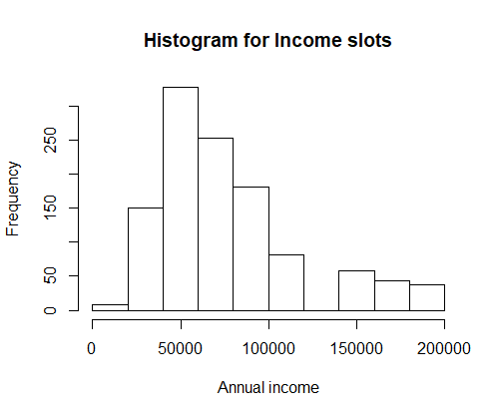
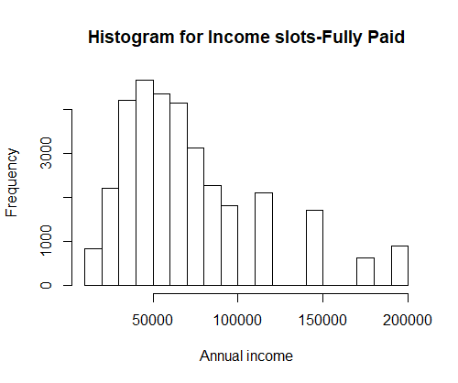
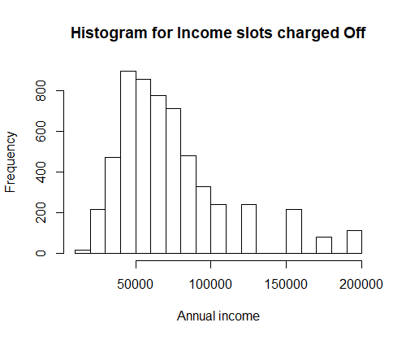
Annual Income range for each loan status
Annual income 30000 to 80000 is more frequent for both Charged-Off and fully-paid Loans
63% of the Charged-Off and 75% fully paid customers are concentrated in this region.
As the both are in the same region , we need to focus on other factors for risk
Current loan status customers are concentrated between 40000 to 100000 ( Annual Income Range)
This indicates investor showing interest to invest on customers in this annual income range

Slide 7
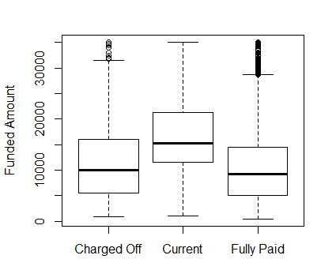
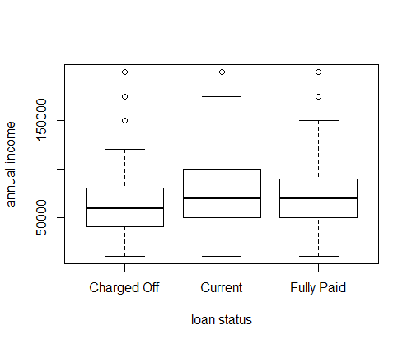
Funded Amount and Annual Income
The Median for Loan Status - Charged-Off and Fully-Paid is 10,000
But the Median for Current Loan Status is considerably higher( Bank has aggressive standards for approving Loans – which seems safe )
The Median Annual Income is higher for Current and Fully Paid Loans and Bank is trying to Mitigate Risk of Lending.

Slide 8
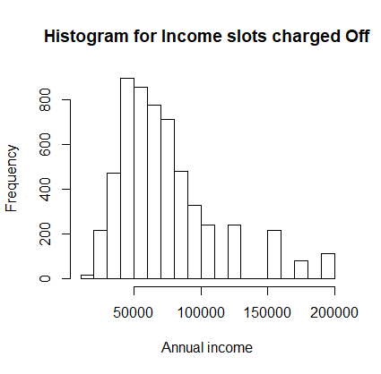
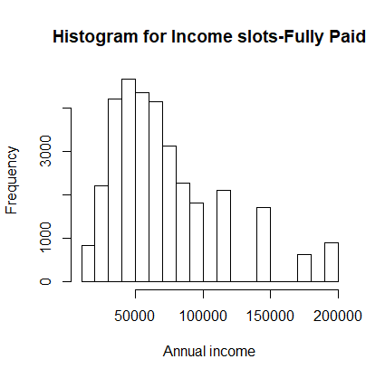
Histogram-Income Slot Analysis
Fully Paid Loans have higher income to loan ratio which shows high income borrowers are low business risk
75% of the customers for Full paid is from 30000 to 80,000
63% of the customers for Charged-Off is from 30000 to 80,000

Slide 9
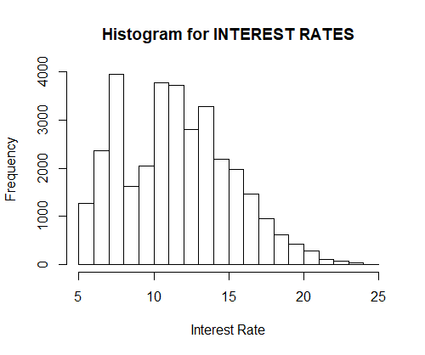
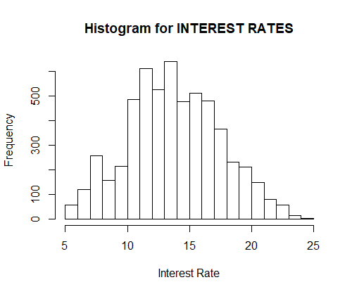
Higher the interest rate, higher the number of Charged-Off loans but we cannot generalize this conclusion.
Interest rate between 10% to 14 % more charged off's exist than other interest rates making these interest rate for Loans and Borrowings Risky
There is a remarkable trend where lower the interest rates charged to loans make people pay the loan with minimum risk and default
Univariate analysis is giving us an idea on data but it is not driving us to conclusion.
Lets draw plots with multiple variables to understand the pattern

Slide 10
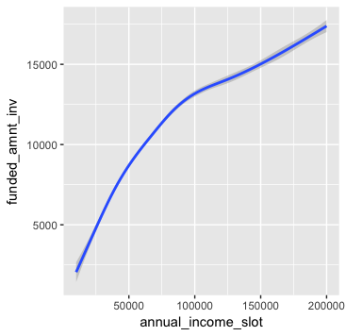
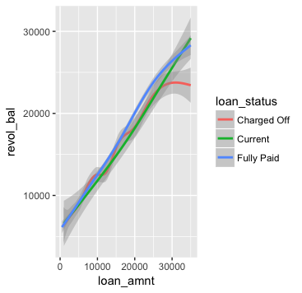
A higher income borrower can get higher loan as the risk is not high as a low income borrower.
There seems to be a definite trend that high income borrower can get a loan amount which is higher than the loan amount secured by a low income borrower.
There is a higher/potential risk as lower revolving balances for charged-off loans with higher loan amounts show even more risk

Slide 11
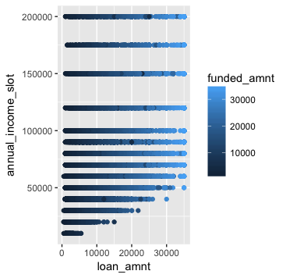
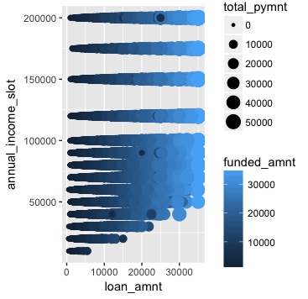

Slide 12
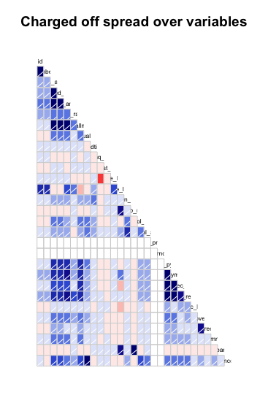
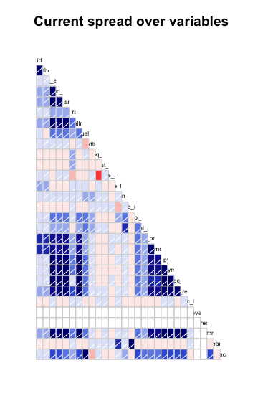

Slide 13
Charged Loans Univariate Risk Analysis – Funded Amount
In fully paid there are lots of high value loans and there is no problem fro the re-payment of the loan but the charged-off Loans and the ones which are not high-value loans
There is a correlation between Loan Amount and Funded-amount

Slide 14
Risk Analysis
 | Total Data Set | Charged | Fully Paid | Current
1. Total number of (count)
2. Average ( Mean )
3. Median
4. SD ( Standard Deviation )
5. 25 %
6. 50%
7. 75%
8. 100%
9.
10.

Slide 15
Univariate Risk Analysis
Annual Income Plots

Slide 16
Driving Factors
Emp Title , home_ownership , annual_inc --- most important one .. we must prove it suing correlation , Verification_status, purpose,loan_amnt, funded_amnt

Slide 17
Results through Plots

Slide 18
Visalization

Slide 19
<Results>

Slide 20
Results

Slide 21
<Conclusions>

